Slide 1
CH302: Unit 3 Exam Review
Electrochemistry

Slide 2
Objectives for Today
Condense material into focused learning objectives
Discuss question types for each topic
I have divided this unit into 4 main ideas:
Electrochemical Reactions
Standard Electrochemical Cells
Nonstandard Electrochemical Cells
Real World Applications (Batteries)

Slide 3
Avoiding Common Mistakes
Sign convention is extremely important in this unit. You can get the right answer, but have it be negative – that means you get no credit
Electrical potential is often based on the difference between reduction potentials or the addition of the reduction potential and the oxidation potential
Whenever you solve for an electrical potential, make sure your answer makes sense (for example: if you solve the electrical potential between 1.44V and -.44V and you get 1.00V, your answer does not make sense)
The volt unit is measured in electrical potential per unit charge. Therefore, your tabulated reduction potentials already take into account your n value (don’t multiply reduction potentials)
Don’t forget the exponents on your concentrations Q (Nernst equation)

Slide 4
The Basic Physics of Electrochemistry
The units of electrochemistry begin with charge and make their way to electrical potential
Charge (q) is measured in coulombs (C).
The flow rate of charge is current (I), which is measured in amps (A), or coulomb per second
The voltage is the electrical potential energy per unit charge
Voltage has the units of J/C, but we just use V

Slide 5
Electrochemical Reactions Learning Objectives
Be able to identify the change in oxidation numbers for the species in a chemical reaction
Be able to identify reduction reactions, oxidation reactions, reducing agents, and oxidizing agents
Be able to balance reactions in neutral, basic, or acidic solution
Solve for the strength of standard cells (be able to calculate the exact potential or use reason to determine relative strength)
Be able to understand the importance of the standard hydrogen electrode
Be able to identify and work with the correct reduction potentials based on a provided reaction
Be able to convert between electrical potential and free energy of standard

Slide 6
Electrochemical Reactions
Electrochemistry is fundamentally the study of electrons passing from one species to another. Therefore, there is an observable change in oxidation states for the molecules/elements that comprise the reaction.
Learning Objective: Be able to identify the change in oxidation numbers for the species in a chemical reaction
Electrochemical reactions involve complimentary oxidation and reduction reactions. To understand how these reactions form a complete REDOX reaction, we divide them into half reactions.
Learning Objective: Be able to identify reduction reactions, oxidation reactions, reducing agents, and oxidizing agents
OIL-RIG or LEO says GER
Oxidation: loss of electrons (electrons are a product of the half reaction)
Reduction: gain of electrons (electrons are a reactant of the half reaction)
Note: when identifying reducing, oxidizing agents you must look at the reactant side of the half-reaction. These terms are named after how they influence the other half-reaction (the reactant being oxidized is the reducing agent; the reactant being reduced is the oxidizing agent).

Slide 7
Electrochemical Reactions
Redox reactions are balanced based on the change in oxidation numbers of the species in the reaction
In other words, our electrons need to be balanced to go from a half-reaction to a complete reaction
Reduction: 3 (Cu²⁺ + 2e⁻ -> Cu) = 3Cu²⁺ + 6e⁻ -> 3Cu
Oxidation: 2 (Fe -> Fe³⁺ + 3e⁻) = 2Fe -> 2Fe³⁺ + 6e⁻
Complete: 3Cu²⁺ + 2Fe -> 3Cu + 2Fe³⁺
Learning Objective: be able to balance reactions in neutral, basic, or acidic solution

Slide 8
Electrochemical Reactions
The strength of an electrochemical reaction at standard conditions is based on the sum the electrical potential of the reduction and the electrical potential of the oxidation.
ε°_{cell} = ε°_{reduction} + ε°_{oxidation}
You will solve problems based on tabulated values provided on the exam cover sheet (all of these values are reduction potentials unless stated otherwise!)
Learning Objective: solve for the strength of standard cells (be able to calculate the exact potential or use reason to determine relative strength)
Remember, if you are dealing with an electrical cell, the equation above is identical to:
ε°_{cell} = ε°_{cathode} - ε°_{anode}
*in this equation, both ε° values are reduction potentials*

Slide 9
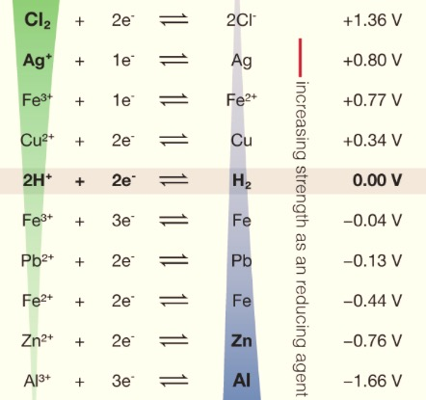
Electrochemical Reactions
The value of ε°_{reduction} that you read on a table, is the relative strength of reduction of your half-reaction compared to the Standard Hydrogen Electrode (SHE).
This reaction describes the reduction of aqueous protons to form gaseous hydrogen. It is the standard for what we call 0V electrical potential.
Therefore, we can observe that the (+) and (-) sign on the half-reaction is only based on how a reaction compares to the SHE.
For a cell, what really matters is the potential difference between the cathode and the anode.
Learning Outcome: be able to understand the importance of the standard hydrogen electrode
Learning Outcome: be able to identify and work with the correct reduction potentials based on a provided reaction

Slide 10
Electrochemical Reactions
Electrical potential energy (ε) can be used to find the free energy of a redox reaction (this is a transition from the electrical world to the chemical world). This equation is:
ΔG = -nFε
A few observations about this formula:
You are going from electrical potential per unit charge (units of V) to free energy per reaction
That means you n is going to basically indicate the number of electrons per reaction
The F is going to be charge per electron
Therefore, your final value for free energy will be free energy per mole reaction
Learning Outcome: be able to convert between electrical potential and free energy of standard

Slide 11
Standard Electrochemical Cells Learning Objectives
Understand the anatomy/attributes of an electrochemical cell
Compare and contrast electrolytic and voltaic cells
Understand electrochemical cell potential in the context of electrolytic and voltaic cells
Be able to determine a reaction based on shorthand cell nomenclature and vice versa

Slide 12
Standard Electrochemical Cells
An electrochemical cell is a device that controls electrochemical reactions. The main components are:
An anode (the site of oxidation) – “An Ox”
A cathode (the site of reduction) – “Red Cat”
A wire (permits the flow of electrons from one compartment to another)
A salt bridge (counters the change in chemical charge within a compartment)
The key differences:
A voltaic cell has negative free energy and a positive electrical potential. The cathode is designated a (+) and the anode is designated a (-).
An electrolytic cell has a positive free energy and a negative electrical potential (requires energy to occur). The cathode is designated a (-) and the anode is designated a (+).
Learning Outcome: understand the anatomy/attributes of an electrochemical cell
Learning Outcome: compare and contrast electrolytic and voltaic cells

Slide 13
Overview of Voltaic and Electrolytic Cells
My shortcut for the +/- on the anode and cathode is to think about where the electrons *want* to go. Remember: electrons are attracted by positive charges and repulsed by negative charges
In a voltaic cell, the negative charged anode pushes the electrons and the positively charged cathode attracts the electrons
In an electrolytic cell, the cathode doesn’t want the electrons and the anode wants to keep them. So the cathode is negative and the anode is positive, and we have to put an external power source to push the electrons in the direction we want.

Slide 14
The Electrochemical Cell
Consider an electrochemical cell made using copper and iron. We are going to design a battery and an electrolytic cell given the following half reactions:
Cu²⁺ + 2e⁻ -> Cu (0.34V)
Fe³⁺ + 3e⁻ -> Fe (-0.04V)
Remember: ε_{cell} = ε_{reduction} + ε_{oxidation}
Battery voltage: 0.38V = 0.34 + -(-0.04)
Electrolytic voltage: -0.38V = -0.04 + -(0.34)
-Learning Objective: Understand electrochemical cell potential in the context of voltaic and electrolytic cells

Slide 15
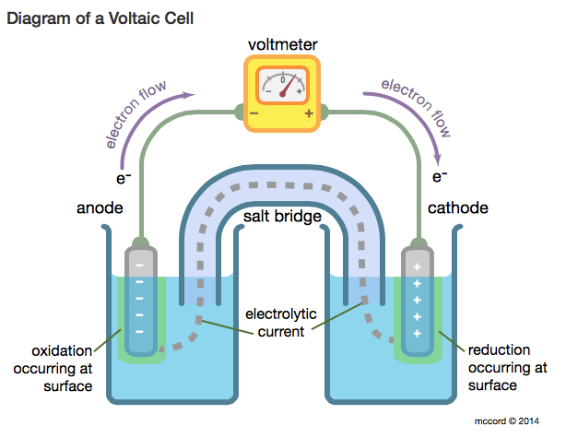
Voltaic Cells
The voltmeter *obtains* a current
Salt bridge accounts for the electrochemical gradient: the gradient that exists based on both the balance of chemicals and of charges
The reaction at the anode (oxidation) is pushing the electrons to the cathode
The cathode will typically gain mass when aqueous particles plate on it
Cl⁻
Na⁺
Fe -> Fe³⁺ + 3e⁻
Cu²⁺ + 2e⁻ -> Cu
Battery voltage: 0.38V = 0.34 + -(-0.04)

Slide 16
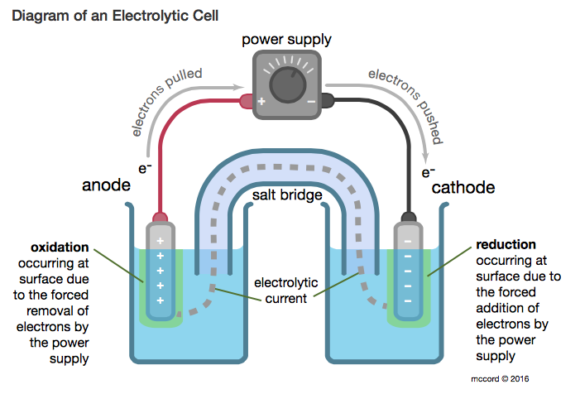
Electrolytic Cells
The power source *inputs* a current
The external power source is pulling the electrons away from the anode
Cu -> Cu²⁺ + 2e⁻
Fe³⁺ + 3e⁻ -> Fe
Electrolytic voltage: -0.38V = -0.04 + -(0.34)

Slide 17
Standard Cell Nomenclature
The standard cell nomenclature outline is as follows:
Anode Electrode | Anode reactant| Anode Product || Cathode reactant | Cathode Product |Cathode Electrode
However, you have also seen reactions that look like this:
*Note: any inert electrode is not stated in the balanced chemical reaction*
Easy:
Difficult:
-Learning Objective: Be able to determine a reaction based on shorthand cell nomenclature and vice versa

Slide 18
Nonstandard Electrochemical Cells Learning Objectives
Be able to solve for a new electrical potential based on provided concentrations
Be able to solve for Q or the concentrations of the products or reactants given a new electrical potential
Be able to answer conceptual questions about variables in the Nernst Equation
Be able to use the Nernst equation to solve for K at equilibrium

Slide 19
Nonstandard Electrochemical Cells
The Nernst Equation is your transition from standard conditions (1M concentrations, room temp) to actual conditions. We call these nonstandard cells.
Don’t forget: Q is based on the chemical equilibrium unit– that means your exponents are important
-Learning Objective: Be able to solve for a new electrical potential based on provided concentrations
-Learning Objective: Be able to solve for Q or concentrations of the products/reactants given a new electrical potential

Slide 20
Nonstandard Electrochemical Cells
Understanding the Nernst Equation conceptually can help you reason with problems
Think about what happens to electrical potential as you change Q:
At standard conditions, Q = 1
If you make Q > 1, your log (Q) term will be positive– this makes your cell potential lower
If you make Q < 1, your log(Q) term will be negative – this makes your cell potential greater
-Learning Objective: Be able to answer conceptual questions about variables in the Nernst Equation

Slide 21
Nonstandard Electrochemical Cells
If you set ε° = 0, you have a dead battery. This means your reaction has reached equilibrium. You may rearrange your Nernst equation to solve for K.
= 0
Q = K
-Learning Objective: Be able to use the Nernst equation to solve for K at equilibrium

Slide 22
Real World Applications Learning Objectives
Be able to solve for any variable in the metal plating equation
Identify types of batteries
Be able to contrast and identify primary and secondary cells
Show how to optimize a given battery
Understand the properties of fuel cells (we will discuss tomorrow)
Understand corrosion and how to prevent it (we will discuss tomorrow)

Slide 23
Real World Applications: Metal Plating
A common use of electrochemistry in industrial manufacturing is metal plating. This involves running a reduction reaction to form a metal from its ions in solution. These experiments are run at a consistent current and the amount of metal plated is given by the equation:
Note: a common mistake students make is with units. In this equatio, t is in seconds, current is in charge per seconds, and n is in moles of electrons per mole metal product
-Learning Objective: Be able to solve for any variable in the equation

Slide 24
Real World Applications: Batteries
Primary cell batteries: non-rechargable, one-time use batteries
Secondary cell batteries: rechargable; as you use them, they are voltaic (spontaneously provide current); they are electrolytic when you recharge them (an input of current is required to run the electrochemical reaction that restores the original reactants).
Learning Objective: be able to contrast primary and secondary cells
Optimizing batteries is simple, logical:
You want to maintain potential when not in use
If possible, you want to store potential for as long as possible
You want to use safe materials for the environment

Slide 25
Real World Applications: Battery Examples
Primary cell batteries: non-rechargable
The batteries you are used to growing up.
Dry-cell, alkaline cell, Lithium cells
AA, AAA, D-batteries; what you buy at CVS
Secondary cell batteries: rechargable
Phone batteries, lithium ion batteries
A common, very important type of secondary cell is the Lead-Acid battery. These are the heavy, rechargeable car batteries, and have been around for quite a while.
Learning Objective: identify common types of batteries

Slide 26
Extra Slides, Questions

Slide 27
Electrical Potential Question
Which species will reduce Cu²⁺ but not Pb²⁺?
Fe²⁺
H₂
Zn
Fe³⁺
Your first thought she be about spontaneity. The framing of this question implies that the reaction will occur without an external power supply.
You should look for the species where E_{reduction} + E_{oxidation} is positive for a reaction with the copper (II) ions but not with the lead (II) ions.
Because you are looking for a reducing agent, you are looking for the reverse reaction that is on the chart (this rules out Fe³⁺)

Slide 28
Electrical Potential Question
Which species will reduce Cu²⁺ but not Pb²⁺?
Fe²⁺
H₂
Zn
Fe³⁺
Your first thought she be about spontaneity. The framing of this question implies that the reaction will occur without an external power supply.
You should look for the species where E_{reduction} + E_{oxidation} is positive for a reaction with the copper (II) ions but not with the lead (II) ions.
Because you are looking for a reducing agent, you are looking for the reverse reaction that is on the chart (this rules out Fe³⁺)
Ans: B

Slide 29
Homework Question
Use Nernst. Ans: 0.0733 V

Slide 30
Not-so-Quick Review Question
You work for a company and your boss asks you to mass produce Zinc metal from Zn(NO₃)₂. While running the reaction at a current of 3.4 amps, you bump your head and fall into a coma. When you wake up, you return to your job and realize that your reaction never stopped running (no one at your job likes you so they didn’t even notice you were gone). You measure 4.2 x 10⁸ kg Zinc metal. For how long were you in a coma?
Use electroplating formula:
It/nF = moles plated.
Ans: 11.56 million years

Slide 31
Not-so-Quick Review Question 2
How much energy would be required to first make spontaneous the reversal of the combustion of methane in acidic conditions? Note: the E° for the combustion of methane is 1.06V.

Slide 32
Not-so-Quick Review Question 2
How much energy would be required to first make spontaneous the reversal of the combustion of methane in acidic conditions? Note: the E° for the combustion of methane is 1.06V.
Solve for free energy using 8 electrons and -1.06V. Ans: 818kJ

Slide 33
Quick Review Question
Hint: look for the best oxidizing agent and the best reducing agent to get the largest value for E.

Slide 34
Quick Review Question
Hint: look for the best oxidizing agent and the best reducing agent to get the largest value for E.
Answer: cobalt (cathode); zinc (anode)

