Slide 1
CH302: Unit 4 Exam Review
Fundamentals of Nuclear, Kinetics

Slide 2
Common Mistakes
Myths we told you, and why they’re not true:
Myth: Stoichiometry doesn’t matter in kinetics
Stoichiometry is essential for determining the rate order of elementary steps
Stoichiometry is essential for determining “relative rates” of reactions
Stoichiometry does not necessarily indicate anything about the rate given the overall balanced reaction (this should be obvious now that we know all about mechanisms)
Myth: The order of a reaction or reactants are whole number integers
When using the method of initial rates, empirically derived rate orders can be any value (fractions included)
In CH204L, we rounded the rate order – in reality, we do not round the empirical rate order
You can end up with fractional rate orders when you take a square root in kinetic equilibrium problems or when solving for the rate using the method of initial rate

Slide 3
Exam 4 Learning Objectives
Kinetics
Complete nuclear reactions with a given unknown (identify the missing decay particle or product)
Define nuclear particles: associated atomic number, mass, and charge
Understand how the “band of stability” can predict decay events
Calculate the change in energy or mass associated with a nuclear reaction
Define and differentiate fusion and fission
Calculate the rate of consumption and production given the overall balanced chemical reaction
Rate law concepts: understand the attributes of a rate law including the definition of rate order, rate constant, dependence on concentration, and the units involved
Empirical rate law: use the method of initial rates to determine the rate order or unknown concentrations of a given reaction
Empirical rate law: know the definition and application of pseudo-first order reactions
Integrated rate laws: use the integrated rate laws to determine the value of k or concentration at a given time
Integrated rate laws: use the integrated rate laws to determine solve problems using half-life given information about the order
Apply the rate law equations to graphs given information about the order of the reaction
Understand that there are four main factors that affect rates
Understand how temperature affects the rate
Understand the main role and properties of a catalyst
Arrhenius law: Solve for new temperatures using a change in the rate constant (k) or vice versa
Apply Arrhenius law to graphs relating activation energy and temperature to the rate constant
Use the elementary step of a reaction mechanism to determine the rate law
Apply the ideas of kinetic equilibrium to solve for the rate law of a provided mechanism
Identify the intermediates and reactants/products of a reaction mechanism
Identify the data associated with reaction coordinate diagrams
Understand the attributes of transition state theory

Slide 4
Nuclear Learning Objectives
Complete nuclear reactions with a given unknown (identify the missing decay particle or product)
Define nuclear particles: associated atomic number, mass, and charge
Understand how the “band of stability” can predict decay events
Calculate the change in energy or mass associated with a nuclear reaction
Define and differentiate fusion and fission

Slide 5
Nuclear Chemistry Basics
You should be aware of the 4 main types of nuclear decay:
α decay: emission of an α-particle
The result is a new atomic species (z-2, m-4) and a new mass
Note: an alpha particle is a charged helium ion because it has 0 electrons. A chemist would write it as He²⁺
β decay: emission of an electron
The result is a new atomic species (z+1) with the same mass
β⁺ decay: emission of a positron
The result is a new atomic species (z-1) with the same mass
Electron capture: the addition of an electron
The result is a new atomic species (z-1) with the same mass
Neutrons are also common byproducts/reactants of nuclear reactions
The affect of neutron release (m-1) or absorption (m+1) is a change in atomic mass without a change in a change in z
Neutrons often pair with other reactions (fusion or fission, for example), so there are other changes going on to the nuclei
Define nuclear particles: associated atomic number, mass, and charge

Slide 6
Nuclear Chemistry Basics
It is worth mentioning that these are very simple to visualize as chemical reactions, as shown below:
Alpha decay:
Beta decay:
Beta⁺ decay:
Electron capture:
Complete nuclear reactions with a given unknown (identify the missing decay particle or product)

Slide 7
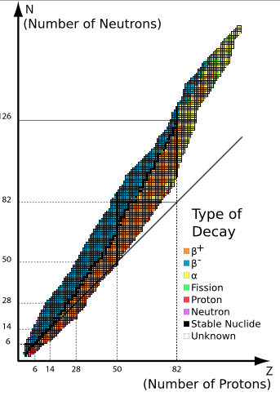
The Band of Stability
The Band of Stability is a tool that shows how stable nuclei favor an ideal neutron : proton ratio
This ratio begins as 1:1, but eventually favors a higher ratio (more neutrons)
You can determine the most likely form of nuclear decay based on the relationship between a selected atom and the band of stability.
Understand how the “band of stability” can predict decay events

Slide 8
The Energy of a Nuclear Reaction
Nuclear reaction produce massive amounts of energy by harnessing the short-wavelength energy potential of matter
The energy of a nuclear reaction can be quantified through the well-known equation:
E = mc²
Energy is expressed in units of joules, meaning your mass has to be kg and your speed of light is meters/second (don’t forget to square c)
Note: these problems can be made far more difficult if we include small scale nuclear reactions (ex: mass defect, binding energy, etc.) – In these cases, you may need to use more complicated units to solve for energy or mass.
Calculate the change in energy or mass associated with a nuclear reaction

Slide 9
Fusion vs. Fission
Fission: the splitting or large nuclei into medium size nuclei
The products of fission are often nuclei larger than iron (anything that is smaller than iron would be an endothermic reaction)
Decay is not a form of fission because the released products are far too small
Fusion: the merging of two small nuclei into a larger nuclei
Fusion typically involves small nuclei, such as hydrogen, deuterium, and helium. However, fusion is technically an exothermic process up until iron.
Similar to my point on fission, beta or alpha capture is not fusion
In summation:
Fission can be spotted by the splitting of large atoms
Fusion can be spotted by the merging of small atoms
Define and differentiate fusion and fission

Slide 10
Kinetics

Slide 11
Quantifying Rates Learning Objectives
Calculate the rate of consumption and production given the overall balanced chemical reaction
Rate law concepts: understand the attributes of a rate law including the definition of rate order, rate constant, dependence on concentration, and the units involved
Empirical rate law: use the method of initial rates to determine the rate order or unknown concentrations of a given reaction
Empirical rate law: know the definition and application of pseudo-first order reactions
Integrated rate laws: use the integrated rate laws to determine the value of k or concentration at a given time
Integrated rate laws: use the integrated rate laws to determine solve problems using half-life given information about the order
Apply the rate law equations to graphs given information about the order of the reaction

Slide 12
The Relative Rate of a Reaction
Definition: The relative rate of a reaction refers to the rate of production per mole reaction (units: M/S)
It should be easy to see that this rate is stoichiometry dependent
For example: the rate of production of a product with a coefficient of 2 will be twice as fast as the rate of production of a product with a coefficient of 1
Common question: why do we divide by the coefficient if the rate is increasing (the answer can be understood conceptually, but it is easiest to plug in values and see how it works)
You can solve for the relative rate of a reaction at any given time provided that you have a graph
Calculate the rate of consumption and production given the overall balanced chemical reaction

Slide 13
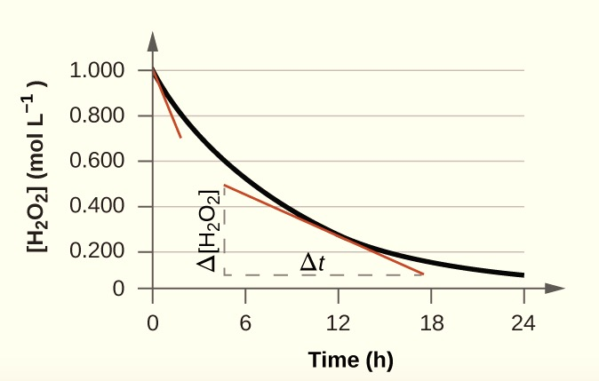
The Relative Rate of a Reaction
You can solve for the relative rate of a reaction at any given time provided that you have a graph
The rate of a reaction at any given time is equal to the slope of the line tangent to your point in time
This image depicts the rate (d[H₂O₂]/dt) at t = 10hrs
Apply the rate law equations to graphs

Slide 14
The Rate Law of a reaction
rate = k[A]^{x}[B]^{y}
This is the most common format to express a rate.
The rate law is often determined experimentally.
The exponents x,y can be any value except 0 (including fractional values)
Note: the exponents can technically be equal to 0, but if they are, we remove that term from the rate law
The order of the reactants is based on the exponents; the order of the overall reaction is the sum of exponents
Our units of k are dependent on the order of the total reaction:
0th order: k = Ms⁻¹
1st order: k = s⁻¹
2nd order: k = M⁻¹s⁻¹
3rd order: k = M⁻² s⁻¹
Rate law concepts: understand the attributes of a rate law including the definition of rate order, rate constant, dependence on concentration, and the units involved

Slide 15
What Does Order Mean?
In chemical kinetics, the order of a reactant is the power to which a reaction depends on the concentration of that particular reactant.
Let’s look at A in our generic reaction: 2A + 3B -> 2C + 3D, where our rate = k[A]^{x}[B]^{y}
0th order: the reaction does not depend on the reactant
X = 0, our [A]^{x} term is equal to 1
Multiply [A] by 2, you have no change in rate
1st order: the reaction depends on the reactant linearly
X = 1, the rate is proportional to any change in [A]
Multiply [A] by 2, your rate multiplies by 2
2nd order: the reaction depends on the reactant squared
X = 2, the rate is proportional to any change in [A]²
Multiply [A] by 2, your rate multiplies by 4
Rate law concepts: understand the attributes of a rate law including the definition of rate order, rate constant, dependence on concentration, and the units involved

Slide 16
Methods of Initial Rates
***There are a few questions on this topic, so please know it!***
The following reaction is the bromination of pentene:
C₅H₁₀ + HBr -> C₅H₁₁Br
The rate is written as rate = k[C₅H₁₀]^{x}[HBr]^{y}. Use the following data to solve for x, y, and k:
Trial # | [C₅H₁₀] | [HBr] | Rate
1 | 2M | 2M | 10M/s
2 | 4M | 2M | 20M/s
3 | 4M | 4M | 40M/s
This equation can be expanded for more than 2 reactants!
Be familiar with the equation:
Empirical rate law: use the method of initial rates to determine the rate order or unknown concentrations of a given reaction

Slide 17
Methods of Initial Rates
Trial # | [C₅H₁₀] | [HBr] | Rate
1 | 2M | 2M | 10M/s
2 | 4M | 2M | 20M/s
3 | 4M | 4M | 40M/s
What are you doing here:
You are measuring the initial rate of a reaction to determine the dependence of the rate on the concentration of your reactants
This experimental technique can be applied to reactions with more than two reactants, and sometimes there is not a clear way to cancel out all your terms – trust your equation if you get stuck
Rate orders do not have to be whole number integers
Eventually you can solve for x, y, and k using the equation:
Rate = k[C₅H₁₀]^{x}[HBr]^{y}

Slide 18
Solution
Trial # | [C₅H₁₀] | [HBr] | Rate
1 | 2M | 2M | 10M/s
2 | 4M | 2M | 20M/s
3 | 4M | 4M | 40M/s
Between trials 1, 2: we doubled the concentration of pentene and the rate doubled. No change was made to bromine.
Between trials 2, 3: we doubled the concentration of bromine and the rate doubled. No change was made in pentene. This is indicative of a reaction that is first order in bromine.
Now that we know the order of the reaction, we can set up our equation: rate = k[C₅H₁₀]¹[Br₂]¹. The reaction is second order overall.
We can use any trial to solve for k. For example: 10M/s = k(2M)(2M), k = (10M/s )/ (2M)², k = 2.5M⁻¹S⁻¹
Important: trials 1, 3 don’t make for a great comparison at the beginning because both reagents have different concentrations. It’s difficult to determine which reagent is causing the rate to change

Slide 19
Pseudo-First Order: Definition, Application
Suppose: rate = k[A][B]
It is much easier to calculate the rate of a first order reaction than a second (or higher) order reaction
We can therefore design an experiment where one of our reactants remains relatively unchanged. We do this by making the concentration of B way larger than A
In other words, the order of [B] virtually becomes 0 for any experiment we run with these concentrations
This changes our rate to a first order expression:
New rate law: rate = k’[A]; where k’ = k[B]
We can use the data we get from a pseudo-first order experiment to determine the rate constant of the corresponding second order reaction
What does this mean? If we set up an experiment to determine k’, we can get back to k simply by dividing out the concentration of the high concentration
k = k’/[B]
Empirical rate law: know the definition and application of pseudo-first order reactions

Slide 20
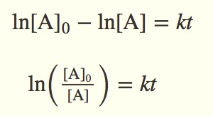
The Integrated Rate Law of a reaction
(Integrated Rate Law for first order)
Rate laws are great for determining the initial rate, but they are unable to directly predict the rate or concentration of a product/reactant at any given time in the future (or in the past)
The integrated rate law solves this by directly measuring concentration at any given time
Integrated rate law questions can be easily identified because they generally ask for or provide 1) initial and final conditions and/or 2) an amount of time that has elapsed. Also, notice how the rate is nowhere in the equation (this is because the rate is changing for every second of time elapsed)
Integrated rate laws: use the integrated rate laws to determine the value of k or concentration at a given time

Slide 21
Applying Integrated Rate Law
In general, integrated rate law questions require you to just implement the proper equation.
However, the order is essential to decide which equation to use and it’s not always obvious. There are some rules you should know:
Half lives: radioactive decay events are always first order; decay events that are independent of concentration are always second order
Graph axes: the axes on a graph can indicate the order of a reaction
Integrated rate laws: use the integrated rate laws to determine the value of k or concentration at a given time

Slide 22
Applying Integrated Rate Law: Straight Line Form
The integrated rate laws can be written to yield straight lines on the curves. The main difference between them is the axes:
All graphs have time as the x axis
0th order: y-axis is concentration
1st order: y-axis is the natural log of the concentration
2nd order: y-axis is the inverse of the concentration
The other difference is the slope
0th and 1st order have a negative slope (slope = -k)
2nd order has a positive slope (slope = k)
Apply the rate law equations to graphs given information about the order of the reaction

Slide 23
Applying Integrated Rate Law: Radioactive Decay
Radioactive Decay is first order
The equation above is extremely helpful because the natural log term can be rewritten as a ratio, instead of plugging in the actual concentrations.
For example: if a question asks how long it takes for a sample of Carbon – 14 to reach 1/1000 its original amount (provided a value of k), you can substitute the natural log term with 1000.
Integrated rate laws: use the integrated rate laws to determine solve problems using half-life given information about the order

Slide 24
Summary

Slide 25
Factors Affecting Rates Learning Objectives
Understand that there are four main factors that affect rates
Understand how temperature affects the rate
Understand the main role and properties of a catalyst
Arrhenius law: Solve for new temperatures using a change in the rate constant (k) or vice versa
Apply Arrhenius law to graphs relating activation energy and temperature to the rate constant

Slide 26
Four Factors that Affect the Rate and How
Nature of reactants/ Availability of the molecules
Larger surface area = faster rate
Ex: this is the reason why we chew our food (mechanical digestion)
Concentration
Higher concentration, higher rate if your reaction is first order or higher
Increases the rate based on the fact that the rate law is concentration dependent
Temperature
Higher temperature, higher rate always (in this class)
Increases the rate based on the fact that the rate constant in temperature dependent
Catalysts
Catalysts decrease the activation energy, which increases the rate
The activation energy is decreased by modifying the substrate orientation
Increases the rate based on the fact that the rate constant is proportional to the negative activation energy
Understand that there are four main factors that affect rates

Slide 27
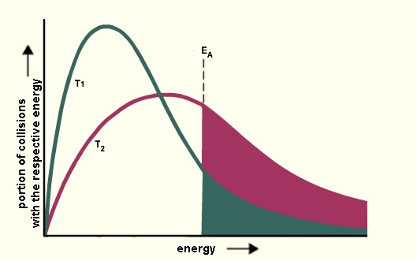
Arrhenius Theory
Temperature can lead to a larger k value
In this course, temperature always leads to a faster rate of reaction; when wondering why, refer to the Boltzmann distribution
A higher temperature increases the number of molecules with significant energy to overcome the activation energy
Boltzmann Distribution
Understand how temperature affects the rate

Slide 28
Arrhenius Law, Temperature
The relationship between temperature and the rate constant (k) is given by the formula:
You can be asked to solve for a new k value or a new T value.
R = 8.314 J/mol x K ; Ea = activation energy (J); T = Kelvin
Things to remember about this formula:
The order of k values is opposite the order of T values
A higher T value gives a higher rate constant
Distribute your terms!
Arrhenius law: Solve for new temperatures using a change in the rate constant (k) or vice versa

Slide 29
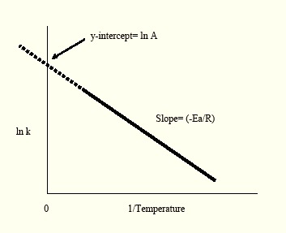
Arrhenius Law, Catalysis
Arrhenius Law can be rewritten as a straight line slope, but the equation isn’t immediately intuitive
The intercept will always be lnA (A is the pre-exponential factor, NOT CONCENTRATION)
The slope will always be -E_{a}/R
The role of a catalyst is to lower the activation energy
Because the slope is related to activation energy, the presence of a catalyst will make the slope less negative
Apply Arrhenius law to graphs relating activation energy and temperature to the rate constant

Slide 30
Mechanisms Learning Objectives
Use the elementary step of a reaction mechanism to determine the rate law
Apply the ideas of kinetic equilibrium to solve for the rate law of a provided mechanism
Identify the intermediates and reactants/products of a reaction mechanism
Identify the data associated with reaction coordinate diagrams
Understand the attributes of transition state theory

Slide 31
Analyzing Steps of a Reaction Mechanism
Consider the addition of chlorine to ethene:
If the first step is the slow step, what is the rate order?
A mechanism is composed of multiple elementary steps
The rate order is based on identifying if the elementary step is unimolecular or bimolecular (the sum of coefficients of the elementary step reactants)
This reaction mechanism can be written rate = k [HCl][C₂H₄]
Identify the intermediate(s)
Intermediates are reagents that appear on both the product and reactant sides of mechanism steps but cancel out of the overall balanced reaction
The intermediates are CH₃CH₂⁺ and Cl⁻
Apply this mechanism to a reaction coordinate diagram…
Use the elementary step of a reaction mechanism to determine the rate law
Identify the intermediates and reactants/products of a reaction mechanism

Slide 32
Mechanisms: Reaction Coordinates
Be able to identify/explain the following on a graph:
The number of steps
The number of “humps” on a diagram; each representing a high energy transition state
The number of intermediates
The number of valleys between humps
The transition states
High energy, transient states
Always represent a higher energy state than the previously existing intermediate/reactant
Activation Energy of the reaction
The energy difference between the reactant/intermediate and the transition state of the rate-limiting step
Rate-limiting step (slow step vs. fast step)
The hump with the greatest change in energy (not always the highest energy maxima on the diagram)
The overall change in enthalpy
The energy difference between the reactants and the products (think thermodynamic state functions)
Understand the attributes of transition state theory

Slide 33
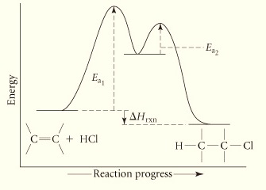
Mechanisms: Reaction Coordinates
Identify the data associated with reaction coordinate diagrams
Consider the addition of chlorine to ethene:
Identify the following:
The number of steps
The number of intermediates
The transition states
Activation Energy of the reaction
Rate-limiting step (slow step vs. fast step)
The overall change in enthalpy
Observe the relationship between the graph and the proposed mechanism. Which step in the mechanism is the slow step?

Slide 34
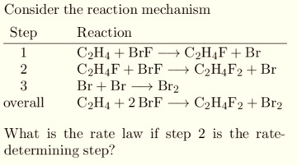
Equilibrium and Mechanisms
Nuclear
When working with mechanisms, you write the rate law in terms of the rate-limiting step.
However, you also want the rate law to be in terms of the actual reactants (not the intermediates)
When the rate-limiting step is not the first step of the proposed mechanism, you have to do some additional work to find the rate law.
What happens that enables us to do these problems is the fast steps that come before the rate-limiting step reach equilibrium. This means the forward rate is equal to the backwards rate.

Slide 35
Problems

Slide 36
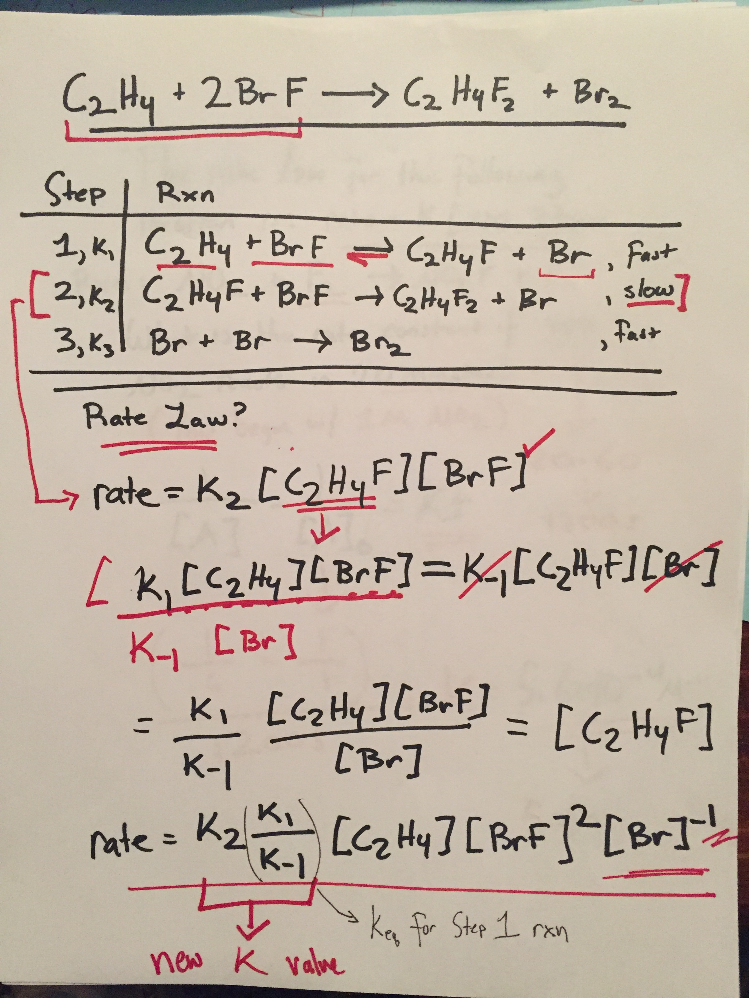

Slide 37
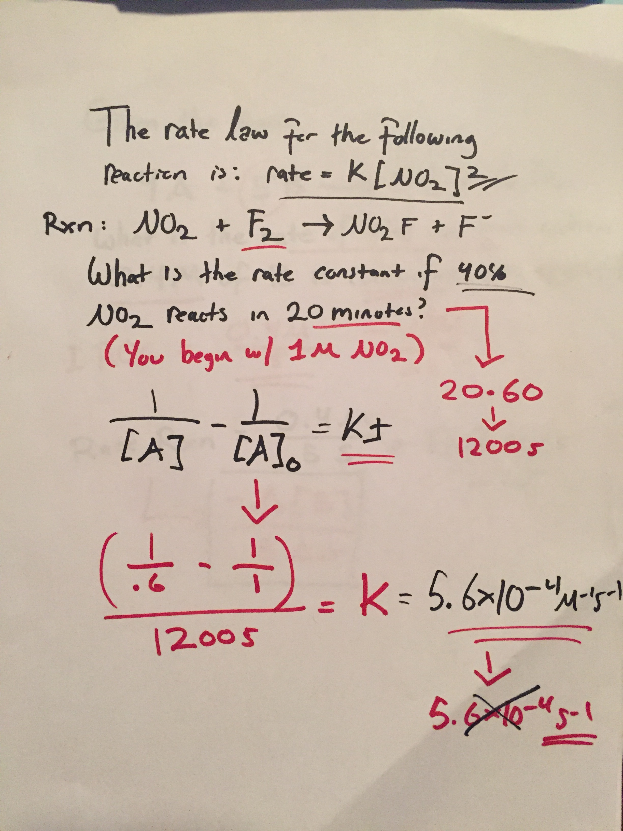

Slide 38
